Slide 1
Energy Systems
Miguel C Brito
mcbrito@fc.ul.pt
8.3.37

Slide 2
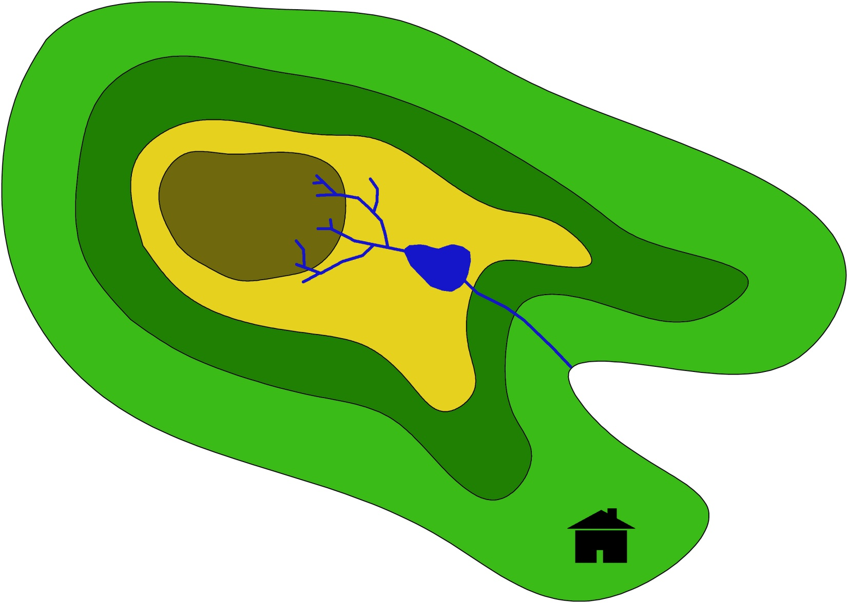
Imagine an energetically isolated island, with 50,000 inhabitants.
(100 people/km², ½ car/person, 2.5people/home)
Available data: hourly time series solar radiation, precipitation, wind and temperature

Slide 3
Class | Topics | Deliverables
1 | Energy Supply.
2 | Tutorial work | Biblio revision
3 | Students’ presentations (1). | PPT1 & DOC1
4 | Students’ presentations (2).
5 | Energy demand. | DOC1_final
6 | Tutorial work | Biblio revision
7 | Students’ presentations | PPT2 & DOC2
8 | Energy storage and transmission
9 | Students’ presentations | PPT3 & DOC3
10 | Energy system
11 | Tutorial work
12 | Students’ presentations | PPT4 & DOC4

Slide 4
General references
Bent Sørensen, Renewable Energy - Its physics, engineering, use, environmental impacts, economy and planning aspects, 3rd Ed, Elsevier Science, 2004
David JC MacKay, Without the hot air [www.withouthotair.com] 2009
Roadmap 2050 – A practical guide to a prosperous low carbon Europe (Technical Analysis) [www.roadmap2050.eu] 2010

Slide 5
Next class
groups!
bibliographic review (e.g. technologies and impacts),
relevant data (efficiency, costs, etc.)
preliminary analysis (look at the time series!)

Slide 6
Group | Energy | Source | Comments | Questions
1 | Mobility | Biofuels |  | kWh(t)/m² €/kWh impact
2 | Electricity | Wind | Onshore (offshore?)
3 |  | Solar | PV on roofs CSP
4 |  | Hydro | Run of the river
5 | Heat | Biomass | Co-generation
6 |  | Solar thermal | Hot water
7 |  | Waste | Biogas and incineration

Slide 7
HYDROELECTRICITY (run of the river)
3 paragraphs about the technology
Goals
kWh(t)/m² (every day, 3 weeks)
€/kWh (assume 40 years project lifetime, 5% discount rate)
Social/environment/economic impact discussion
Interesting number
per capita (kWh/year/person);
energy density (kWh/year/m²)
Height : 50m
Water basin 100 km²
20% direct (time constant = 1 day)
40% indirect (time constant = 3 months)
20% left for the fish
20% losses

Slide 8
Biomass co-generation
3 paragraphs about the technology
Social/economical impacts; rural jobs?
€/kWh; energy density (kWh/year/m²)
Assumptions
crops → ton/ha
GJ/ton
Energy conversion
Explorability coefficient
Costs
Biofuels
3 paragraphs about the technology
€/kWh; per capita (kWh/ano/person); energy density (kWh/year/m²)

Slide 9
Solar electricity
3 paragraphs about the technology
Data: solar radiation time series
€/kWh; per capita (kWh/year/person); energy density (kWh/year/m²)
Photovoltaic
Assumptions: typical efficiency, cost and lifetime; 70m²/roof.
kWh/m²(t).
CSP
Subtract diffuse radiation from global radiation time series (use random number and local temperature)
5MW power plant

Slide 10
Wind energy
3 paragraphs about the technology
Social/environmental impacts
kWh(t)/m² (footprint!)
€/kWh

Slide 11
Energy from waste
3 paragraphs about the technology
impacts!
kWh/year/person
€/kWh.
Incineration or biogas?
Estimate kg of waste per person per day (after recycling!).
Conversion efficiency?
Costs?

Slide 12
Solar thermal
kWh(th)/m²; €/kWh
45 litres at 60ºC per person
Water temperature
Summer | 20ºC
Spring/autmn | 15ºC
Winter | 10ºC

Slide 13
Next week
bibliographic review (e.g. technologies and impacts),
relevant data (efficiency, costs, etc.)
preliminary analysis (look at the time series!)

